Slide 1
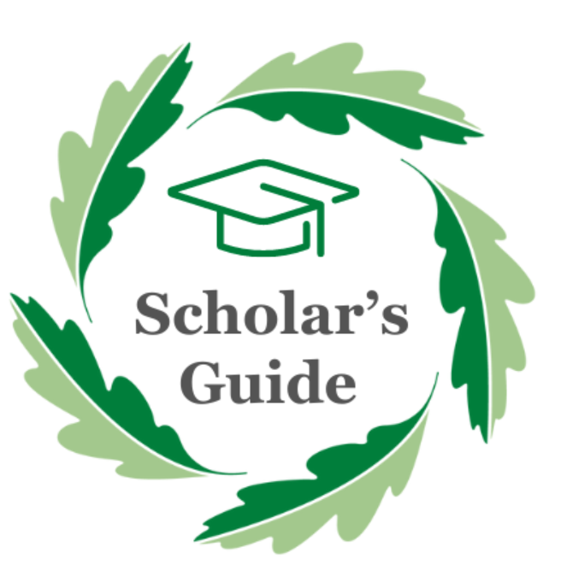

Slide 2
A parent's guide to supporting your child in their use of the Scholar's Guide

Slide 3


The Anthem Way
A cycle for expert teaching to impact every student, every lesson, all the time
Notes:
Visual

Slide 4
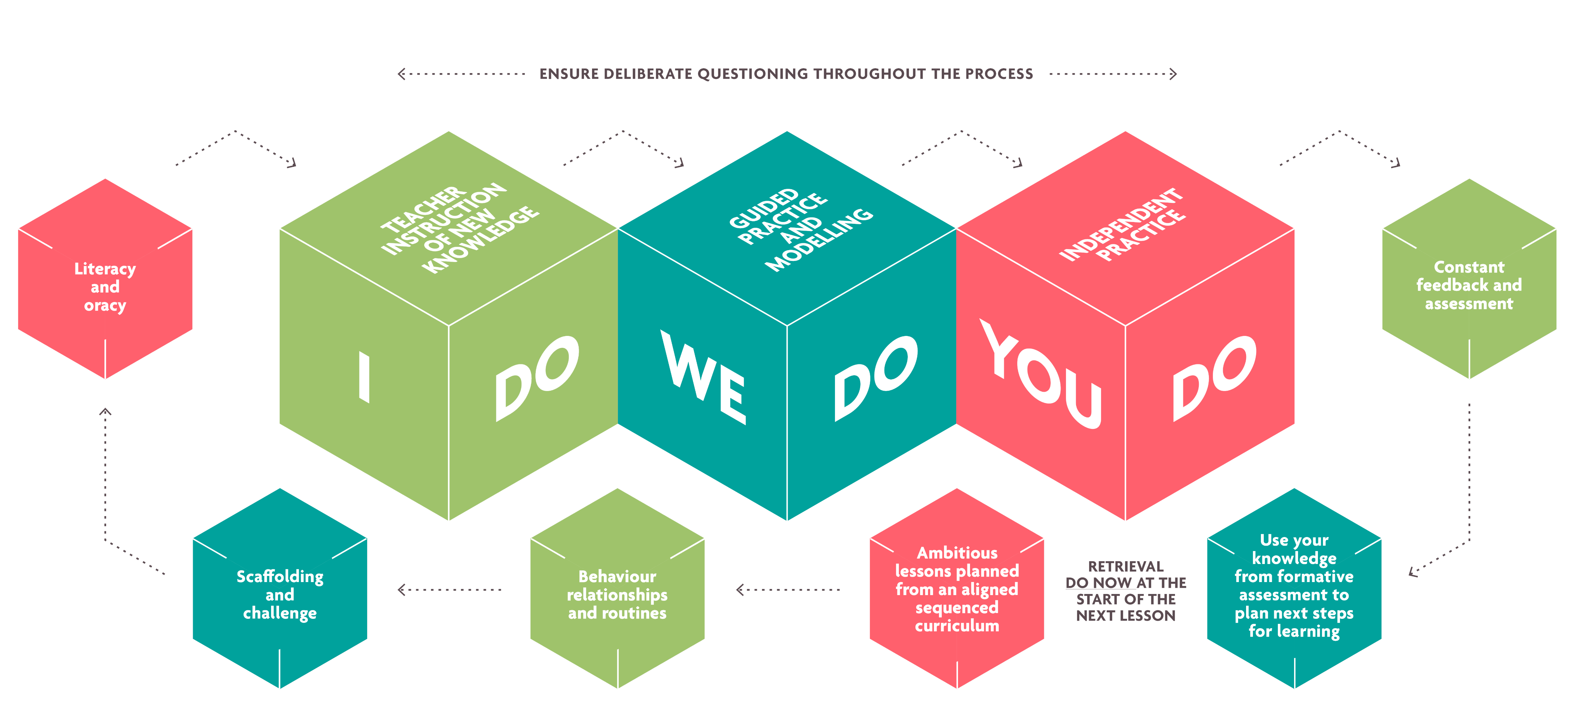
Cumulative fluency
Notes:
The principles have been designed to align in order to ensure that the effect of each is maximised. This will help is with our aim of building cumulative fluency and will ensure that we meet the needs of every student, every lesson, all the time.
Cumulative fluency is when students can apply their knowledge and skills because they have been taught in well sequenced building blocks that build upon themselves over time. With opportunities to retrieve and practise, skills become embedded and gaps are prevented.

Slide 5
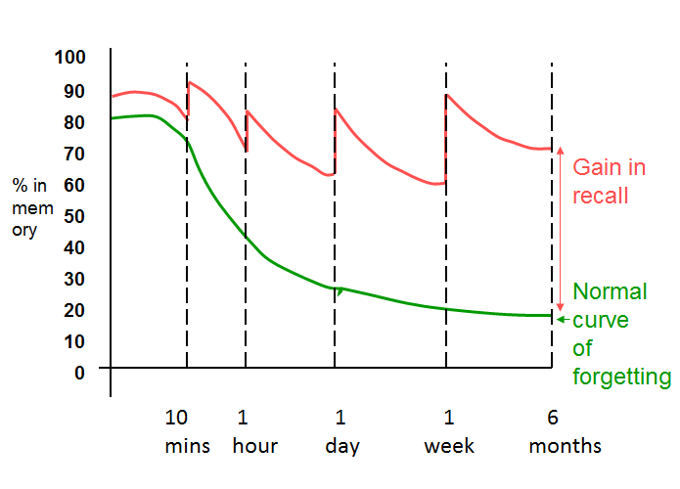
Why?
Topics need to be revisited more than once to help students retain information.
The Scholar’s Guide is designed to enable students to know what they are learning, in what order they are learning it and how their learning is interconnected. In essence, it is designed to take the mystery out of the curriculum.
Students have a retrieval activity at the start of each lesson which we call a fast start. The questions in this section are the from the Scholar’s Guide so already we are asking students to recall knowledge from previous lessons, and if they are stuck, to use the Scholar’s Guide as a working document to fill in the gaps in their knowledge. By continually revisiting the work, over a series of assessment cycles, it is proven that more knowledge will be retained in their long-term memory.
But how can the Scholar’s Guide be used for revision? Each week, students have been learning a bite size revision skill and these (among others) are compiled in this booklet for you.

Slide 6
What is the intended impact of our Scholar's Guides?
The guides include the core knowledge students will need to know. This includes the knowledge we are expected to teach them as part of the National Curriculum and GCSE syllabuses; as well as additional content where appropriate.
The use of command words in the 'so that I can' section supports students in understanding how they can apply this knowledge.
The key vocabulary supports students in accessing the lesson content.
The end of term assessments enable us to work out patterns and trends of what the students have retained.
The Super Teaching Week enables teachers to reteach areas of the course that students have clearly struggled with and challenge any misconceptions they may have. This then enables them to move on to the next topic with a secure understanding of what has come previously.

Slide 7
Setting up for success
Where should they revise?
Ideally a clutter free desk in a quiet area of the house. Distractions should be at a minimum so no mobile phone or tv!
What will they need?
All students really need is a pen and paper, alongside their Scholar’s Guide. Some students may want to use flashcards, highlighters or different coloured pens.
When should they revise?
It is important to consider a meaningful length of time that they can revise for but working too much or for too long can be counterproductive. Have regular rest breaks and be realistic about what they can cover.
It is important to remind your child that they aren’t expected to remember everything. Some areas they will find information easy to retain; other areas it will be more of a challenge. The whole idea of assessment weeks is to find gaps in students' knowledge and to support them in overcoming these in Super Teaching Week.

Slide 8
Strategies
The following pages contain some of the strategies that our students have practiced in Personal Development each week. During each bite size session on this, they have had an opportunity to practice each skill.

Slide 9
What is self-quizzing?
This is a crucial skill in your use of the Scholars Guide and will be an activity you can do independently when preparing for assessments. It is also one of the best revision skills you can master!
Watch the following video to see how this works:
How to self quiz using a knowledge organiser (youtube.com)

Slide 10
Why does self-quizzing work?
Think of your favourite film. You can probably imagine the plot, the characters, the actors and one or two of the best scenes. If you saw just a couple of minutes of the film, could you recognise when this movie was on the television? If you heard some dialogue, could you confidently say if it came from your movie or not?
The answer is almost certainly yes. This is easy. It is recognition of something you are watching or hearing. In the same way that you can recognise your favourite film from a poster, you can probably recognise the main ideas of your academic subject when you see them.
Revising as a group can give you an opportunity to quiz and test each other. Have a go at explaining topics to others without referring to your notes. It’s a great way to aid your own memory and understanding

Slide 11
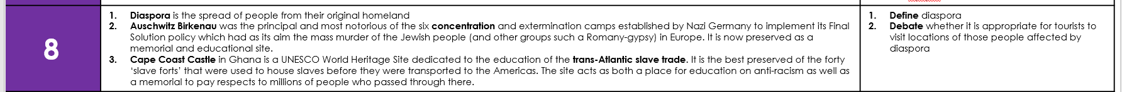
How does being quizzed by someone else work?
Revising as a group can give you an opportunity to quiz and test each other.
It can help to explain a topic to others without referring to your notes. It’s a great way to aid your own memory and understanding
What kind of questions could you ask? Eg
What is the word used to describe the spread of people from their homeland?
Where is the Cape Coast Castle located?

Slide 12
What are flashcards?
Flash cards are small, double-sided pieces of card or paper. On one side you write a question or key term. On the other side you write the answer or definition.
There is always a relationship between the information on both sides of the card, e.g. key term and definition, question and answer etc.
Because you can only see one side of the card at a time, you can use flash cards to test your knowledge, by instantly checking your guess.
Flash cards are an effective tool for revising keywords, vocabulary, and other subject specific information.

Slide 13

How can you use flashcards using the Scholar’s Guide?
Buy a fresh set of blank flash cards or create your own by cutting up card or paper.
On one side of the card, write a key term or question (just like when you were self quizzing)
On the other side, write the definition for that key term, or an answer to the question
Stick to one idea or concept per flash card.
Don’t fill the card with a long complex answer either. Keep them as simple as possible.
To achieve this, split bigger answers into smaller sets of questions if necessary, and don’t worry if this means using more cards.

Slide 14
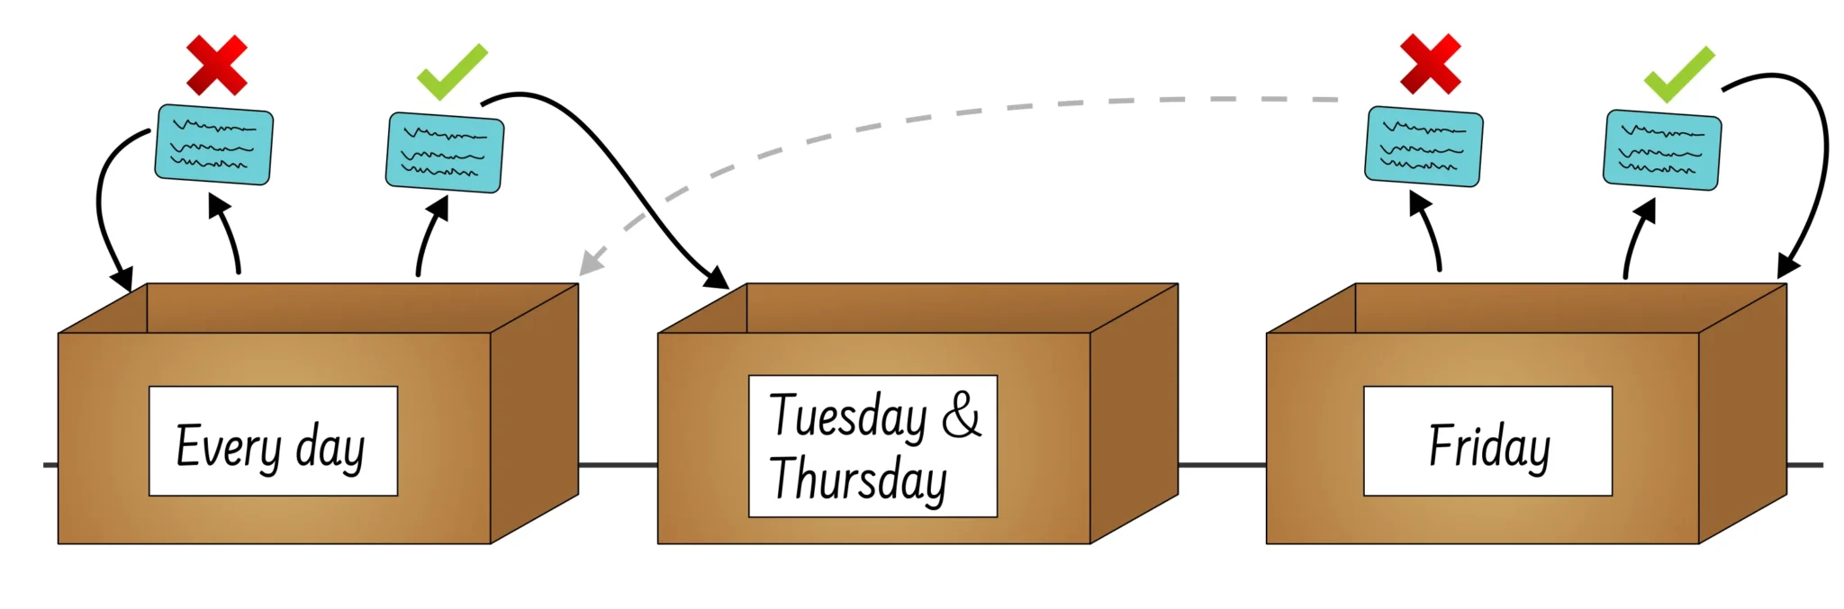
What is the Leitner model?
Unlike traditional flashcard methods the Leitner system forces your brain to retrieve flashcard information at different intervals based on your past successes.
How? By popping your flashcards into separate boxes based on how well you’re recalling what’s on them.

Slide 15

How can you use flashcards using the Scholar’s Guide?

Slide 16
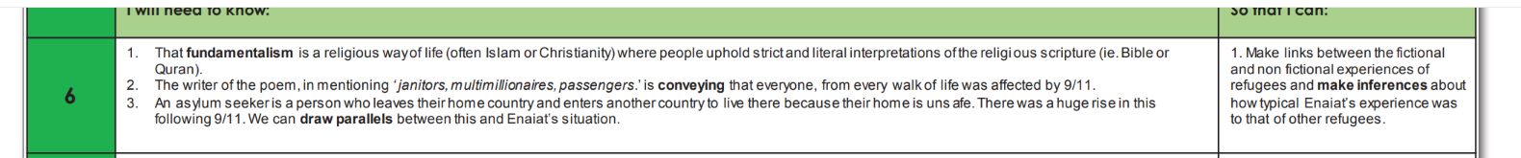
How can you complete additional research?
I could look at additional information on what fundamentalist beliefs looks like in different religions
I could look at information on 9/11 and in particular, what was so significant about it.

Slide 17
How can you tell if your source of information is reliable?
We all know how important it is to get news and information from trusted websites and accounts. But what is a reliable source? How can you tell which ones are genuine and which ones are not?
The 3 key checks to tell if a source is reliable
1. Check who made it
Some sources are more reliable than others – make sure you’re getting news from journalists and official news sites, rather than just social media. Journalists are held to account for what they report and any story in a news outlet will have gone through checks and an editor. So have a look at what they’ve previously written and if their news seems accurate and unbiased – that they just report on the facts, rather than giving an opinion.
2. Check multiple sources
If the same information can be found on other websites or accounts, it might suggest that what the source is saying has been verified by other people too.
Checking multiple sources is a great way to make sure that a person can be trusted, as it shows that other reporters have come to the same conclusion about a news story and that it’s more likely to be true.
3. Check for reliable evidence
Have a look to see if the writer, journalist or even social media source is backing up their story with trustworthy evidence. It’s always a good sign if you can find where the news has come from and clearly see the facts behind the piece.
It’s also good to ask yourself if what the source is saying sounds believable. If it appears a bit out of this world or too good to be true, then the chances are that it might well be.

Slide 18

Sometimes when you are completing additional research (as we discussed last week), you can find an overwhelming amount of information....

Slide 19
Using the skim and scan method can be most helpful
Skimming and scanning are two useful reading techniques. They can help you to find information really quickly in a text.
Skimming is when you look over a text quickly to get the general idea of it. You don't need to read every word - just pick out key words and sentences.
Scanning is when you look over a text quickly, line by line, hunting for key words, dates, names and numbers. It's a useful skill to use when you need answers to specific questions.

Slide 20
Skimming
Read the first paragraph and last paragraph in full.
Read the opening words and closing words of the paragraphs in between.
Use headings, sub-headings, bullet points or key words
(those in bold, italics, capitals or underlined) to guide you.

Slide 21
Scanning
You don't need to read every word. Just look for the information you want.​
Again, use headings, sub-headings, bullet points or key words to guide you.​

Slide 22
Dual Coding
Dual Coding theory is the process of blending both words and pictures whilst learning.
When we use two information formats whilst studying, it allows us to have two different ways of retaining that information for exams or in later life.
Revision Strategies #8 - Dual coding (youtube.com)

Slide 23
Additional strategies (not yet covered but worth a mention!)

Slide 24
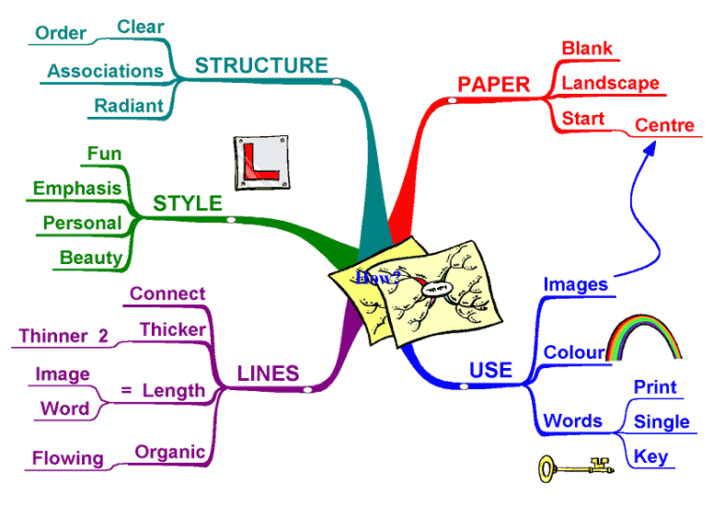
Mind Mapping
Try making mind maps rather than normal notes. A mind map makes the best use of your memory, allowing you to put a lot of information onto one sheet of paper.
To create a mind map:
Place your page in landscape position
In the centre, words or an image which stands for the whole topic
Between 5 and 9 factors on a mind map to create a good mind map
Only use keywords. WRITE IN CAPITAL LETTERS
Write on top of the lines and make your words fit the exact length of the line
Spread your branches around the map – make them an ORGANIC shape
If you can use dual coding. This helps to use both sides of the brain.

Slide 25
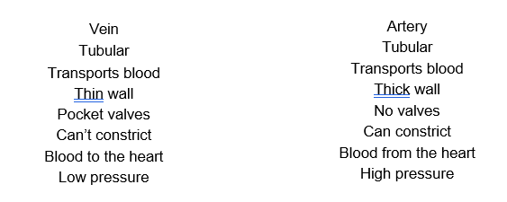
Split lists
These can be used to show the two sides to an argument, showing for and against points or to show similarities and differences between things. E.g. to compare the two types of blood vessel.

Slide 26
Word patterns
Using word patterns can help to jog your memory, particularly using the initial letters of each word to form a new word.
E.G.
The principles of training can be remembered as SPORT
Specificity
Progression
Overload
Reversibility
Tedium

Slide 27
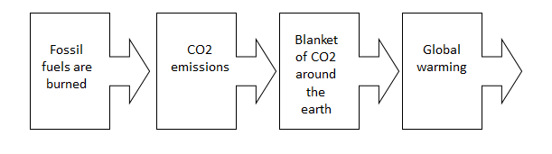
Flow diagrams
These can help to revise a sequence of what happens next and why. This flow chart shows how global warming takes place.

Slide 28
Healthy Body and Healthy Mind
We do not want any student to feel unnecessarily stressed or anxious about the assessment weeks. If they have engaged in the lessons and have spent time looking over the Scholar’s Guide, then they will absolutely be prepared for the Cycle 3 Assessment.
Having a good night’s sleep is vital when studying hard, so having a regular time when they
switch off lights and sleep is important.
It is also important that they do something when they have finished studying for the evening to help them relax such as catching up with friends on social media, watching videos/TV, reading, listening to music, gaming etc.
Eating well reduces overall stress on the body and can also make a person feel good about themselves. Exercising helps to clear the mind and provides a way of releasing a great deal of the muscle tension which stress produces.

